Slide 1
BATCH A7 DOMAIN : MACHINE LEARNING
BY: (BE. IV-CSE A )
AISHWARYA T M (2018PECCS105)
ASHMIN ANGEL A (2018PECCS111)
SRINIDHI ISWARYA B.K (2018PECCS214)

Slide 2
TITLE
Crime Analysis and Prediction using Optimized KNN Algorithm

Slide 3
SCOPE
The main goal of a project is to
The objective of this project is to tackle a vital issue in the society - Crimes. Analyzing and examining of crimes happening in the world will give us a Broadview in understanding the crime regions and can be used to take necessary precautions to mitigate the crime rates.

Slide 4

TIMELINE CHART

Slide 5
OVERVIEW
Identifying Crime patterns will allow us to tackle problems with unique approaches in specific crime category regions and improve more security measures in society. Current studies show the reason of increase in crime rates is more in areas that are economically backward. In few decades’ property crime will be a target. The following approach involves predicting crimes classifying, pattern detection and visualization with effective tools and technologies. Use of past crime data trends helps us to correlate factors which might help understanding the future scope of crimes

Slide 6
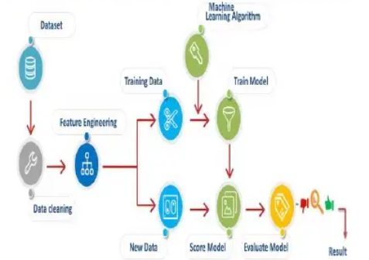
SYSTEM ARCHITECTURE

Slide 7
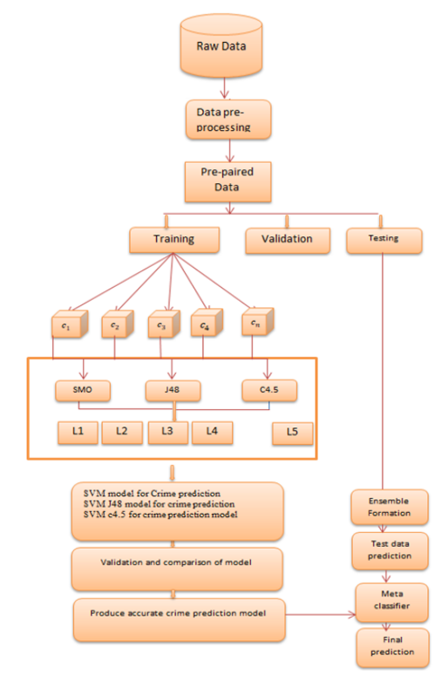

Slide 8
LITERATURE SURVEY
Lawrence McClendon and Natarajan Meghan than presented a comparative study on linear regression, addictive regression and decision tree and found linear regression algorithm to be very effective and accurate in predicting the crime data based on the training set input for the three algorithms.

Slide 9
LITERATURE SURVEY
A survey [8] found that using efficient data collection and data mining techniques to create a better crime prediction using knowledgeable learning to develop multiple models for single problem solving will improve crime forecasting. Prediction output of a single classification that aids in predicting what the next crime may be in a specific district within a given time period and identifies the season and Crime has a time dimension in which it occurs more often.

Slide 10
LITERATURE SURVEY
Babakura et al. presented a comparison between Naïve Bayesian and Back Propagation to predict the crime data and classified on various levels of crime rate such as low, medium and high. The accuracy, recall and precision were also calculated. The Naïve Bayesian was found performing better for data classification tested over crime dataset using WEKA.

Slide 11
LITERATURE SURVEY
Yadav et al. employed different types of machine learning methods supervised as well as unsupervised. Clustering, k-means clustering, Naïve Bayes, Regression methods are studied for analysis of crime rates and their impact based on criminal data.

Slide 12
LITERATURE SURVEY
Hazwani et al. presented a comparative study between different machine learning methods such as SVM, fuzzy theory, artificial neural network. The multivariate time series report was presented as a result of an extensive comparison of crime prediction methods. The futuure scope still explained the limitation of current methods for obtaining better accurate results and good performance by optimizing and tuning the parameters.

Slide 13
LITERATURE SURVEY
LuizG. et al. suggested random forest method for prediction and analysis of crimes using some urban indicators and homicides. This study is based on forecasting crime rate, and number of criminal activities in different indian states A number of regression techniques were used but the prediction results claimed on limited dataset were not upto mark. The future scope opened direction on applying several data engineering, Creating an Intrusion Detector Network, for Creating a Prediction Model.

Slide 14
LITERATURE SURVEY
Xiangyu et al. utilized spatiotemporal patterns in urban data in one borough in a city, and then leveraged the transfer learning techniques to reinforce the crime prediction of other boroughs. A novel transfer learning framework is used to integrate these features and model patio-temporal patterns for crime prediction.

Slide 15
LITERATURE SURVEY
Ensemble learning offers robust methodologies to handle the uncertainties in most complex industrial problems. [16]. In another side Anifowose, F et al. present ANN introduces an ensemble model in a different direction that combines various outputs of seven ‘weak’ learning algorithms and compared to the individual ANN, ANN-bagging and Random Forest to create an ensemble solution for the prediction of petroleum reservoir porosity and permeability.

Slide 16
LITERATURE SURVEY
In another research They suggest the Artificial Neural Networks ensemble model (ANN). Using standard decision rules, the performance of the ensemble model was evaluated and compared to those of ANN-Ensemble with the traditional Bootstrap Aggregation method and Random Forest. The results showed that the suggested method outperformed the others with the highest coefficient of correlation and the least errors.

Slide 17
LITERATURE SURVEY
The ANN ensemble model was developed with ten simple ANN model learners, each using a randomly generated number of hidden learners. For neurons, Each student contributed to improved prediction accuracies of reservoir properties for improved hydrocarbon exploration, development, and management activities, and demonstrated the principle of randomization of the number of hidden neurons, demonstrating the great potential for applying this learning paradigm to the characterization of petroleum reservoirs.

Slide 18
PROBLEM DEFINITION - Existing System
In this system they are proposed logistic regression and K-means classifiers. Researches have been done to study the relation between criminal activities and socio-economic variables like unemployment income level race level of education

Slide 19
PROPOSED SYSTEM
Crime is a social phenomenon as old as societies themselves, and although there will never be a free from crime society - just because it would need everyone in that society to think and act in the same way - societies always look for a way to minimize it and prevent it. In the modern United States history, crime rates increased after World War II, peaking from the 1970s to the early 1990s. Violent crime nearly quadrupled between 1960 and its peak in 1991.

Slide 20
PROPOSED SYSTEM
Property crime more than doubled over the same period. Since the 1990s, however, crime in the United States has declined steadily. Until recently crime prevention was studied based on strict behavioural and social methods, but the recent developments in Data Analysis have allowed a more quantitative approach in the subject. We will explore a dataset of nearly 12 years of crime reports from across all of San Francisco's neighbourhoods, and we will create a model that predicts the category of crime that occurred, given the time and location.

Slide 21
FEASIBILITY STUDY
Crime is a common societal problem that has an effect on people's personal happiness and economic growth. It is regarded as a vital factor in deciding whether or not people should migrate to another city and what places should be avoided while travelling. With the rise of violations, law enforcement agencies are requesting more advanced regional data systems and modern information mining methods to help them better investigate corruption and protect their organisations.

Slide 22
FEASIBILITY STUDY
Despite the fact that violations can occur anywhere, it is essential that when criminals are looking for opportunities to commit wrongdoing, they search in the most common places. We hope to raise people's awareness of dangerous places in different eras by providing an information mining method for determining the most criminal hotspots and discovering the type, place, and time of committed wrongdoings. As a result, our proposed arrangement could allow people to avoid certain areas at particular times while also saving lives.

Slide 23
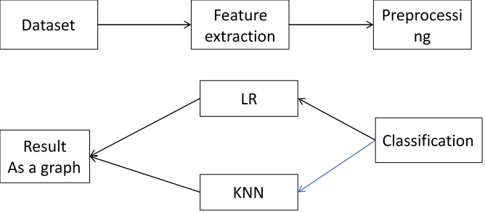
BLOCK DIAGRAM

Slide 24
Hardware And Software Used
Hardware:
1. Windows 7,8,10 64 bit
2. RAM 4GB
Software:
1. Python 2.7
2. Anaconda Navigator

Slide 25
ADVANTAGES
It gives best accuracy value
It accepts large level data’s
we are using modern algorithm like KNN

Slide 26
Base paper
An Empirical Analysis of Machine Learning Algorithms for Crime Prediction Using Stacked Generalization: An Ensemble Approach

